Slide 1
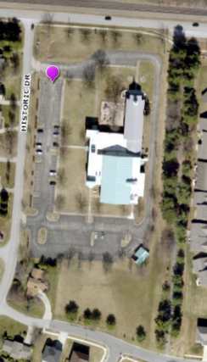

EVACUATION
AREAS
EVACUATION AREA “B”
EVACUATION AREA “A”

